Slide 1
Changing role of public opinion polls in the Czech Republic – 1946 to 2001
Martin Vávra (martin.vavra@soc.cas.cz), Tomáš Čížek (tomas.cizek@soc.cas.cz)
Institute of Sociology of the Czech Academy of Sciences, Czech Republic
13th Conference of the European Sociological Association
(Un)Making Europe: Capitalism, Solidarities, Subjectivities
Key Topics in the Sociology of Knowledge VI: World Views & Politics

Slide 2
Public opinion polls in Czechoslovakia
In our presentation ve seek to introduce various contexts and functions of opinion polls during period 1946-2001 in Czechoslovakia (and Czech Republic since 1993)

Slide 3
Origins of modern public opinion polls
USA in 30´- George Gallup and Elmo Roper
They changed the concept of public opinion – before their times public opinion ment rather opinon of elites (and contraelites)
Mainly for Gallup public’s attitudes and opinion were loaded with political wisdom, and polls were keys to unlock it
„polling of the public, on the issues defined by the public, for the benefit of the public“

Slide 4
Polls come to Czechoslovakia
Institute for public opinion research (IPOR) was established in 1946 – influenced by Gallup´s method and Gallup´s mission
IPOR was department of Ministry of information
After February 1948 (coup d'état led by Communist party) research activities were more and more restricted and in 1950 Institute was closed down
In the same period sociology was destroyed as a „bourgeois pseudoscience“

Slide 5
Renewal of public opinion research in 60´
Around the mid-1960s - rapid renewal of all sociology branches
Reformists in Communist party hoped that social sciences can help them (e. g. with managing economy)
IPOR was reestablished in 1967 as independent institute under Academy of sciences.
Started with „apolitical“ surveys (lifestyle, health), but openly political topics followed soon

Slide 6
Public activity of IPOR during Prague spring (1968)
During 1968 IPOR carried out several polls targeted at political topics
Through public presentation of results IPOR became important actor in „Prague spring“ process
Example: Trust in Communist party (July 1968)
In % | Czechoslovakia | Czechia | Slovakia
Full trust | 11 | 10 | 12
Rather trust | 40 | 34 | 52
Neither/nor | 36 | 39 | 31
Rather distrust | 10 | 13 | 5
Full distrust | 3 | 4 | 0

Slide 7
Public opinion in era of so called „normalization“ (1969 – 1989)
After August 1968 when The Warsaw Pact troops stopped reform process in political sphere, IPOR continued for some time with surveys whose results could be interpreted as potentially critical to political sphere, but Institute was more cautious with their publication.
At the beginning of 1970s IPOR was canceled as a part of academic sphera and reopened with new staff as autonomous department of Statistical office
After 1972 it was controlled directly by Secretariat of Communist party (Ideology and propaganda department)
Topics of polls were strictly controlled
Results weren't published

Slide 8
During 1970s and first half 1980s „social“ topics prevailed (education, family), in second half of 1980s political topics were more frequent but topics and questions were selected in very cautious way.
Data from polls were used in the struggles of the internal factions of Communist party
In 1980s some more pro-reform parts (e. g. economic department of Central comitee of Communist party) used selected results as tool against „tradicionalists“

Slide 9
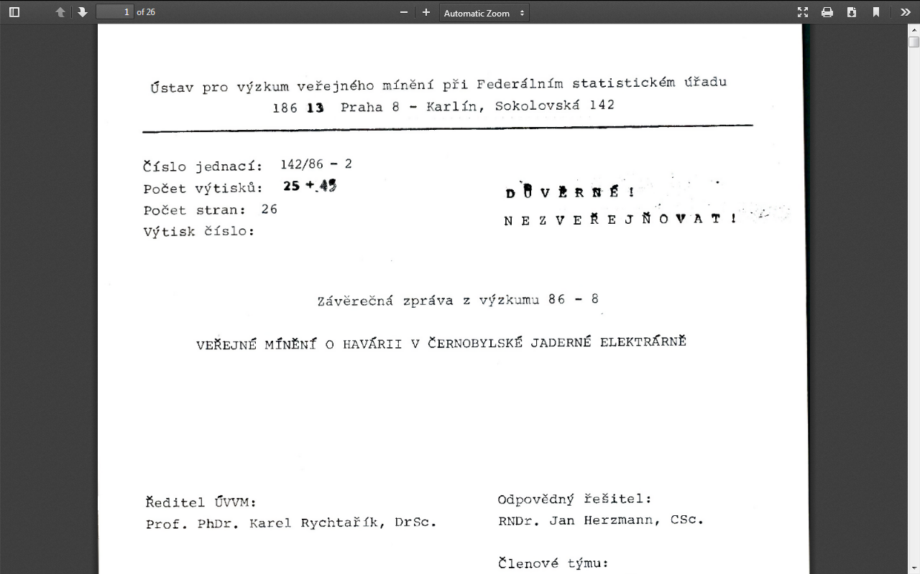
Political issues in polls during normalization Example of „Chernobyl accident“ research

Slide 10
Political issues in polls during normalization Example of „Chernobyl accident“ research
Which media provided better information on Chernobyl accident in opinion of public?
In % | Czechoslovak | Sometimes Czechoslovak, sometimes „western“ | „western“ | Don't know
More understandable | 25 | 25 | 4 | 46
More convincing | 19 | 19 | 9 | 53
More complex | 19 | 20 | 9 | 52
More accuarate | 17 | 19 | 9 | 55
More up-to-date | 11 | 20 | 24 | 45

Slide 11
Velvet revolution and after
During velvet revolution IPOR carried out several quick opinion polls, asking people about their opinion on up-to-date political issues and published the results
After 1989 personal changes in IPOR management took place, but in research staff there was continuity
Many researchers from IPOR were establishing private marketing research and opinion polls companies and left the Institute – that weakened its research potential
Discussions on mission of public opinion research in public institution
In 2001 IPOR returned to Academy of Sciences (as part of Institute of Sociology)

Slide 12
Public opinion under communism and in democratic regime – two different worlds?
From the methdological point of view, polls carried out before 1989 were of high quality
But if we understand polls as form of social power - knowlege of opinions of various publics can help in governing them but at the same time it can empower those publics if results are published – they were fundamentally flawed because of non-publishing results

Slide 13
Presentation was prepared for CSDA Research Project. The work was supported from European Structural and Investments Funds, Operational Programme Research, Development and Education. (reg. no. CZ.02.1.01/0.0/0.0/16_013/0001796).

